Slide 1
University Database
Krishna vardhini K

Slide 2
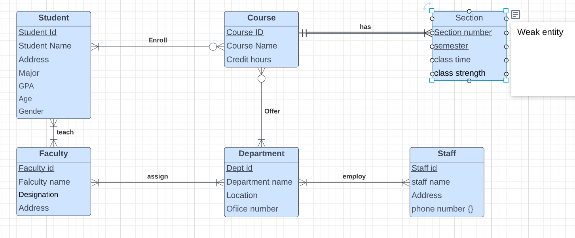
EERD of University

Slide 3
Goal
To use high-level programming language to access the PostgreSQL database and retrieve the data.
Project Overview
Used Python Language to access Postgres SQL
Python Framework Pandas and API Psycopg2 used to connect PostgreSQL
SQL query operations performed viz
Show Table details
Insert record
Delete record
Update record
Count number of students from each department
Search student details with student id
Find maximum salary of each department
List coursid using course name
Search Department salary >2000

Slide 4
Connection establishment Between PostgreSQL and Phython :
Phython
Psycopg2
module
Database connection and passing query
Query passed
PostgreSQL
Query result passed
Query result passed
Psycopg2 the is database adapter for the python programming language
Create connection
Create cursor – connection object
Query execution with method execute()
Close cursor
Close connection

Slide 5
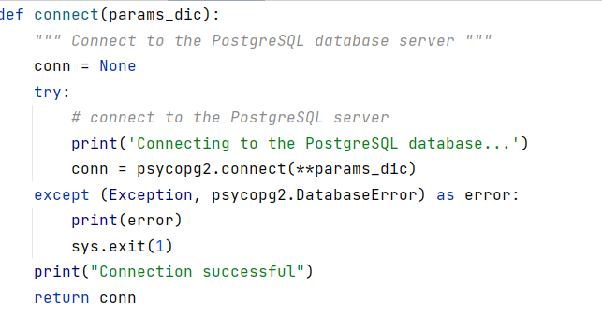
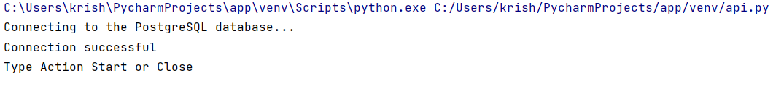
Connection method:
Below Connection parameters passed to connect:
Hostip
Databasename
Username
Password
Port

Slide 6
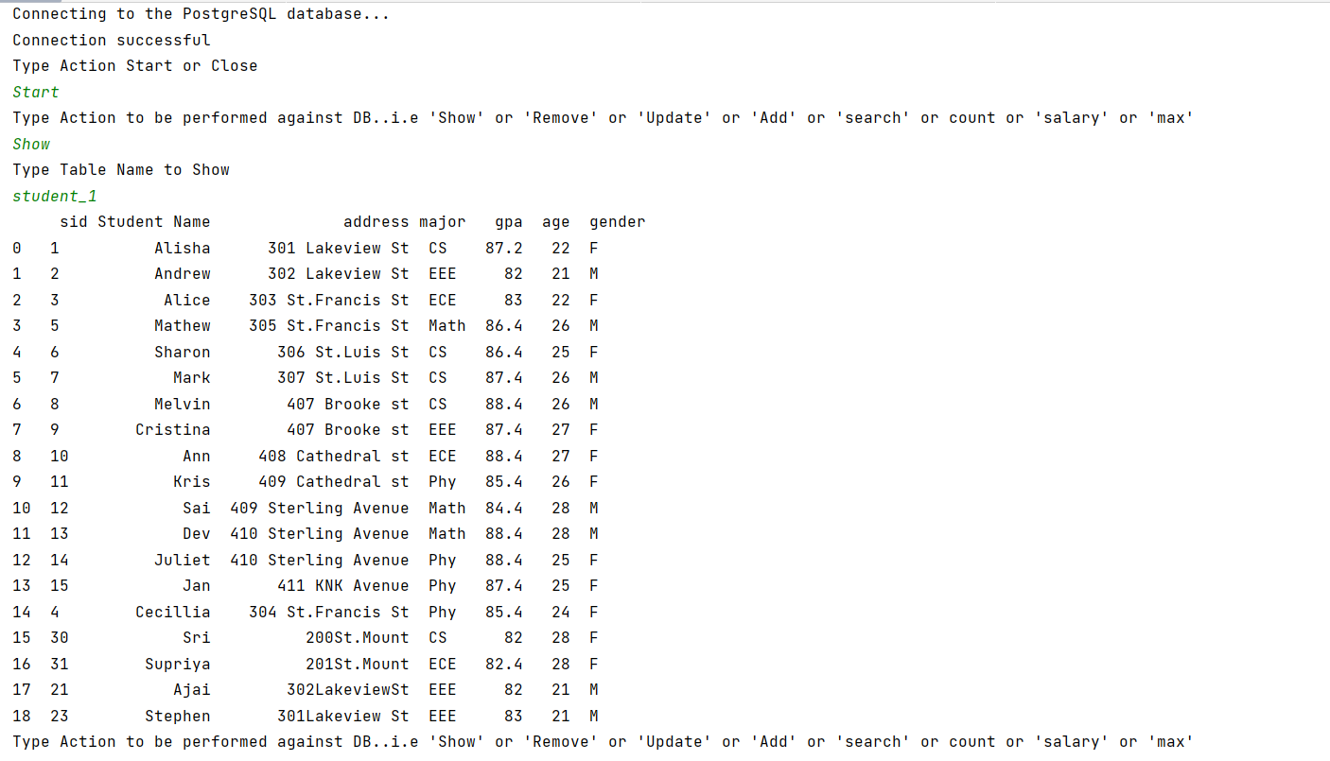
SQL Queries
1.Show student_1 relation:

Slide 7
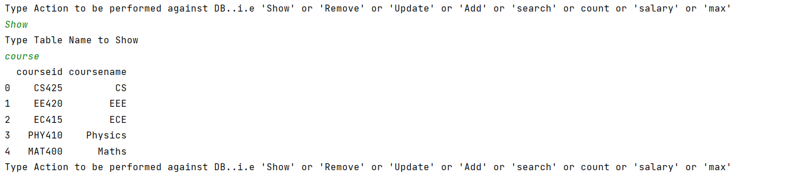
Show course relation:

Slide 8
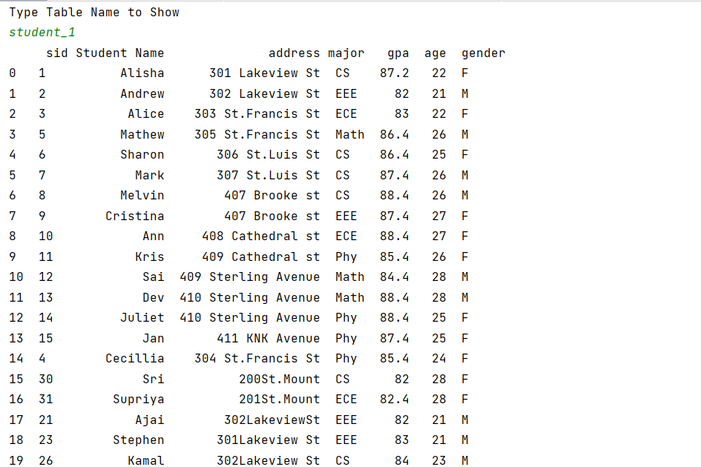
2.Remove:
To delete student record “Kamal” with sid “26”

Slide 9
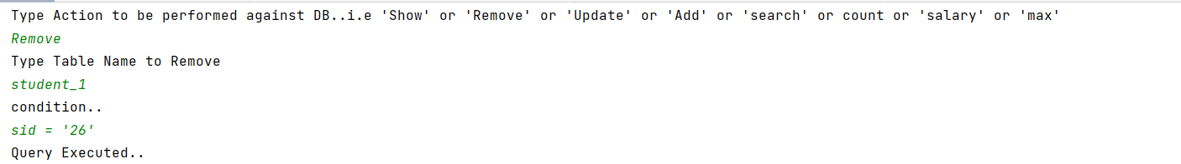
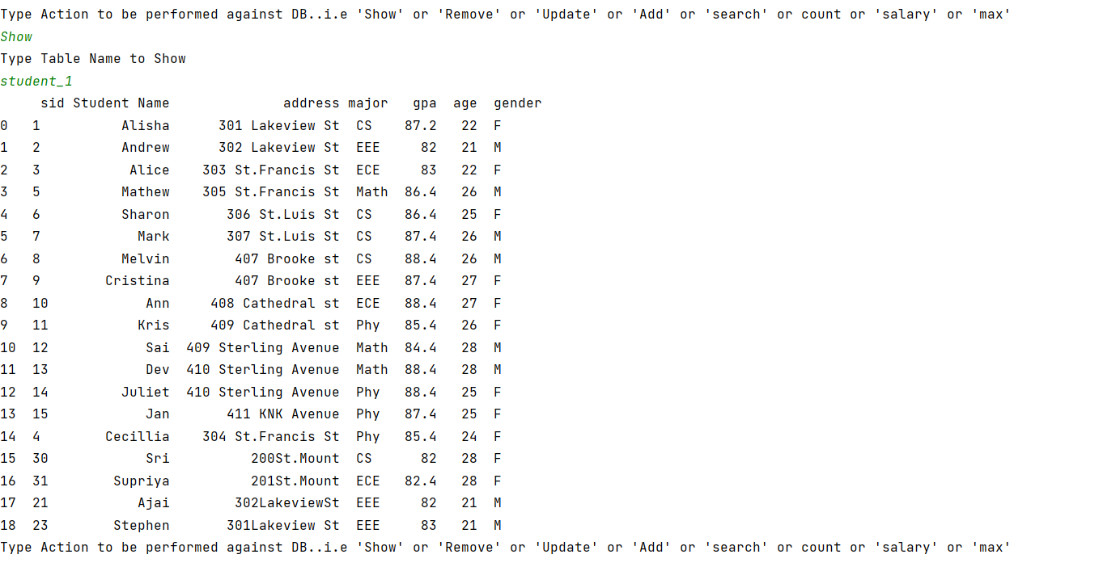

Slide 10
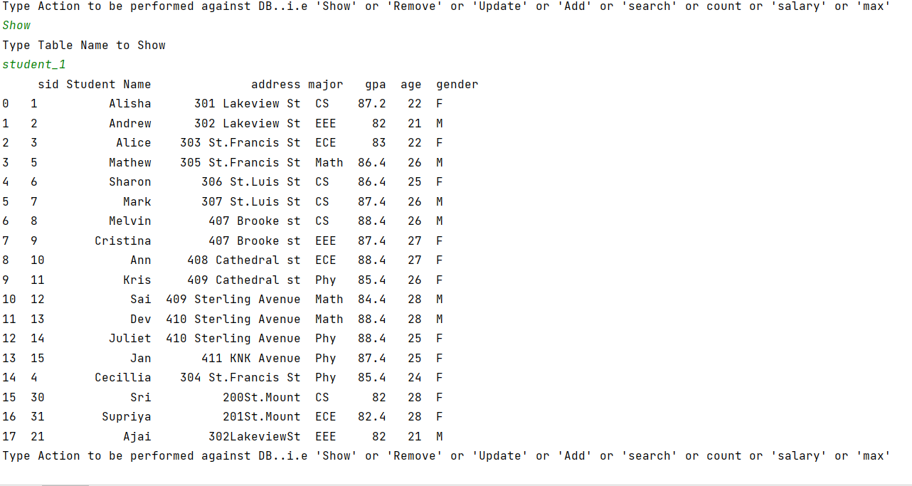
3.Update:
To update student record “Ajai” Gpa with “86”.

Slide 11
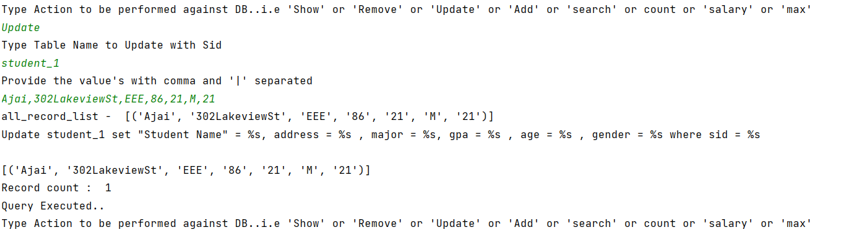
Student Record of “Ajai” updated with Gpa

Slide 12
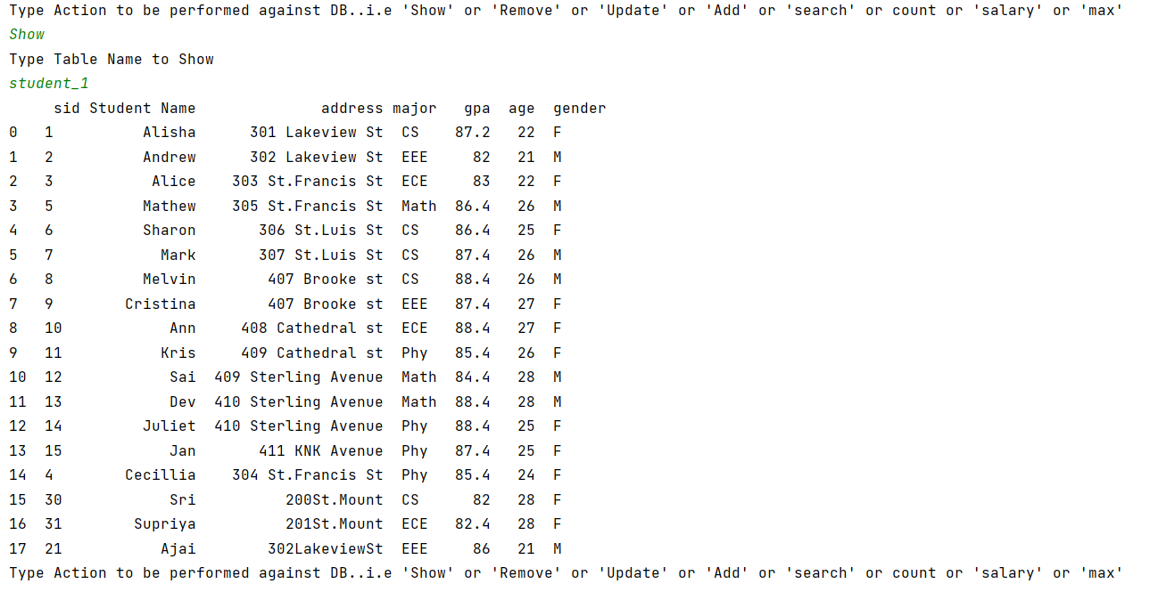
GPA value for sid 21 modified with “86”

Slide 13
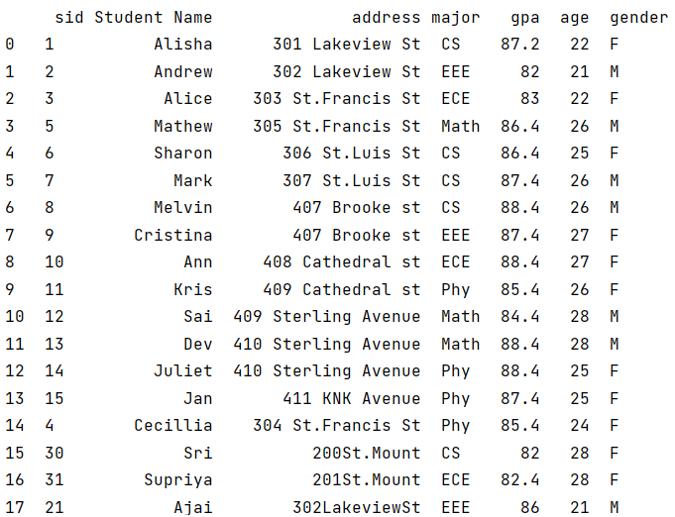
4.Insert
Adding new student details to the student database:
Existing student details

Slide 14
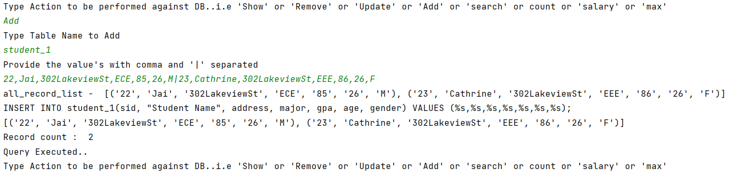
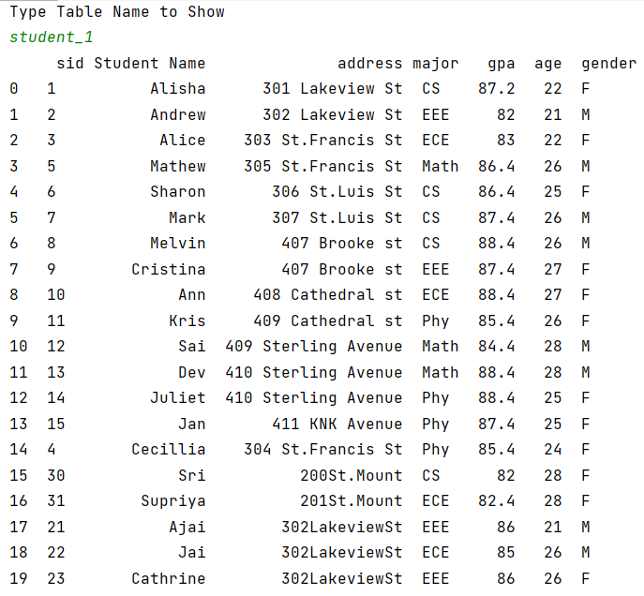
Add action performs insertion of new student records to the student database.
Student details of “Jai” and “Cathrine” records are added.

Slide 15
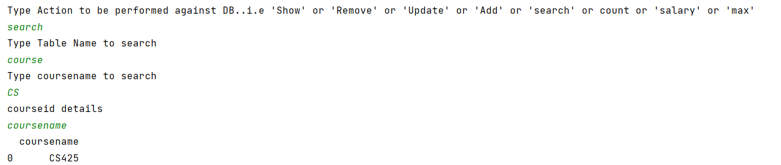
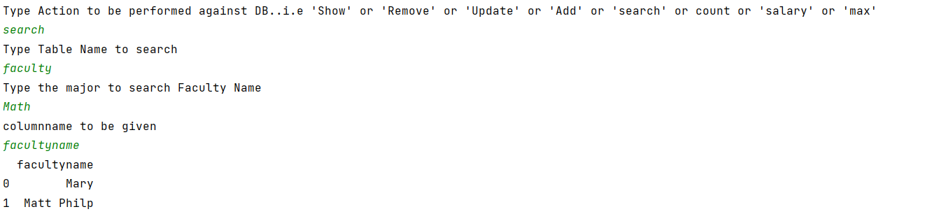
5.Search
To search courseid details given coursename
To search Facultyname list given major

Slide 16
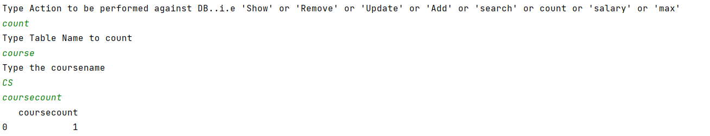
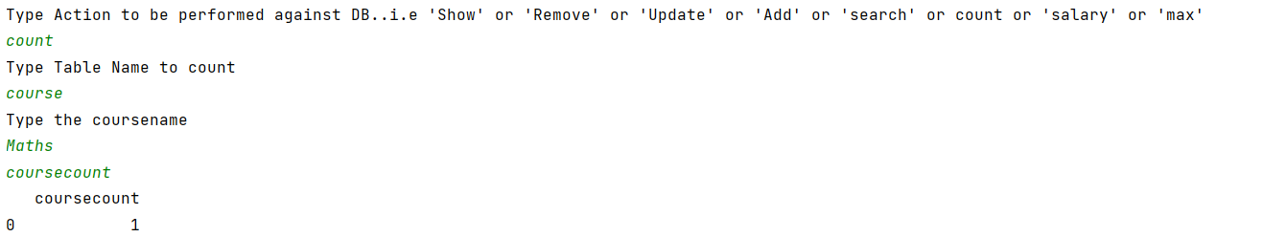
6.SQL QUERY using COUNT
Count the total number of course for major CS
Total number of courses for coursename Maths

Slide 17
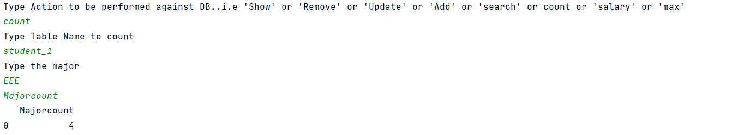
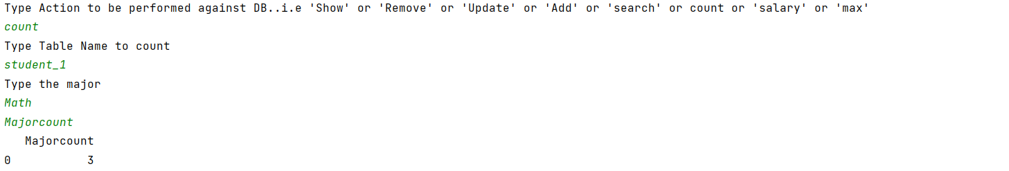
7) Total number students part of Major ‘EEE’
Total number students part of Major ‘Math’

Slide 18
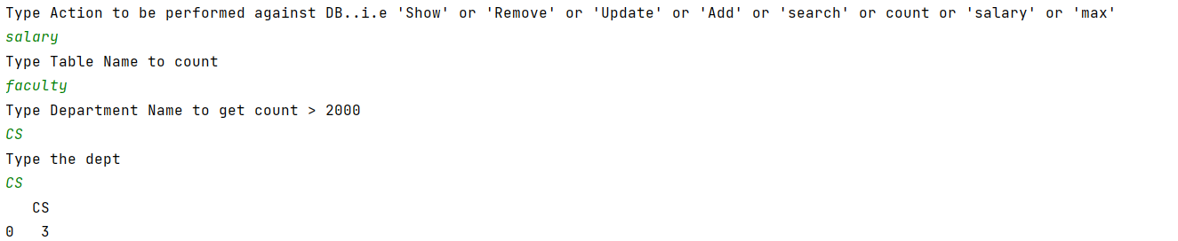
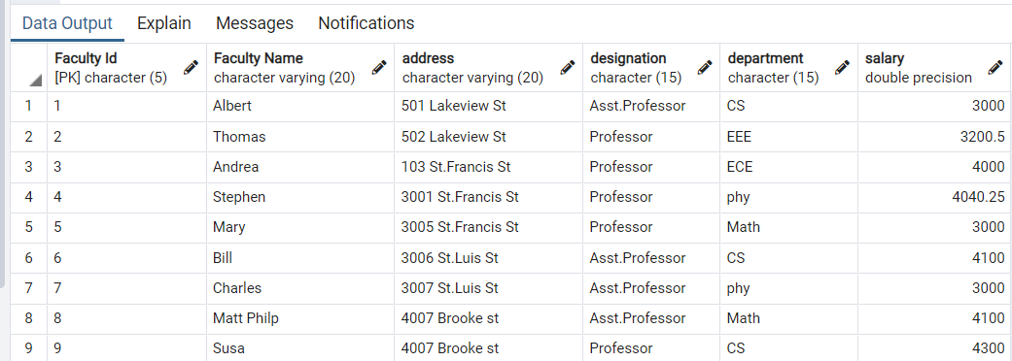
8. To find total number of faculty part of ‘CS’ department having salary > 2000
Relation - Faculty

Slide 19
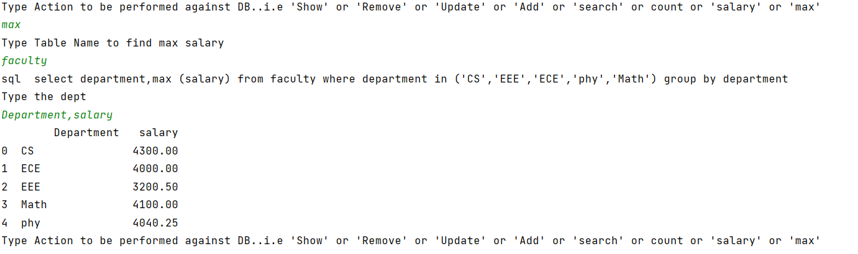
9. To find the maximum salary for each department
Reference Faculty relation

Slide 20
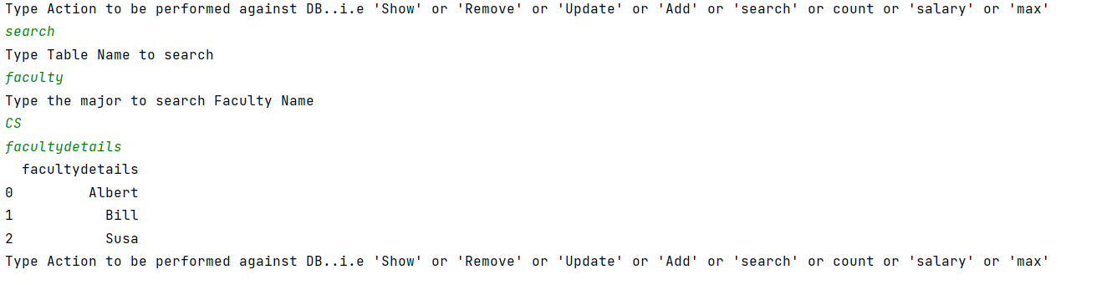
10. List of Facultynames part of CS department:

Slide 21
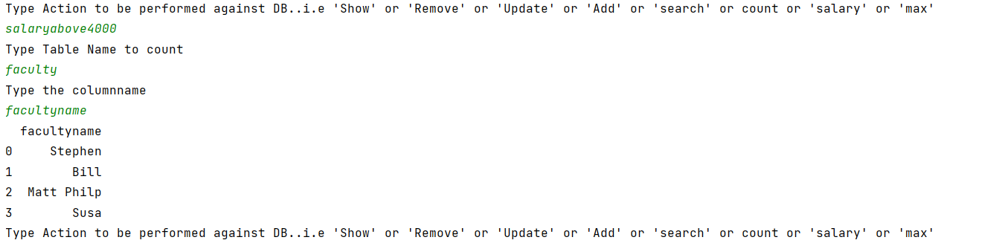
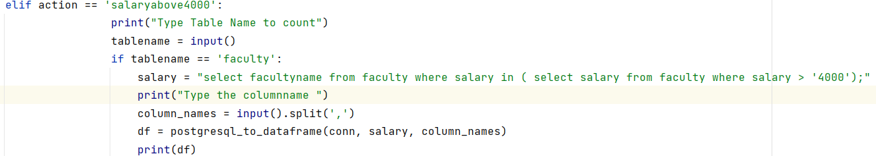
11.Sub Query: List of facultyname with salary >4000
select "Faculty Name"
from faculty
where salary in (select salary
from faculty
where salary > ‘4000');
Code snippet

Slide 22
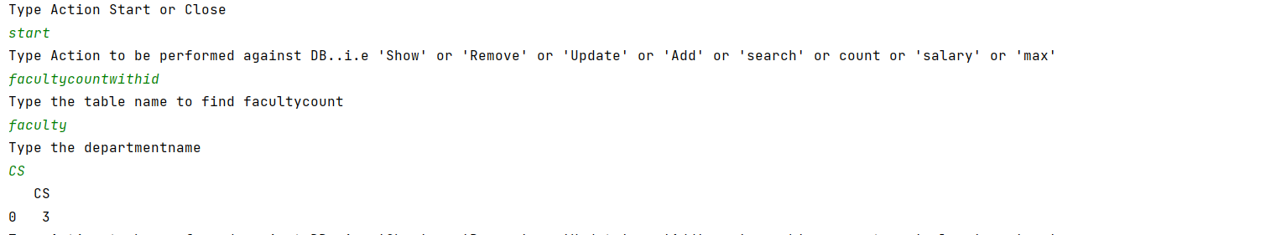
12. Subquery : Facultycount of CS department:
select count ("Faculty Id")
from faculty
where (department) in
(Select department
from faculty
where department = 'CS’)

Slide 23
Thank you

